Slide 1



Customer churn
Vibhaas Vinay Kotwal

Slide 2
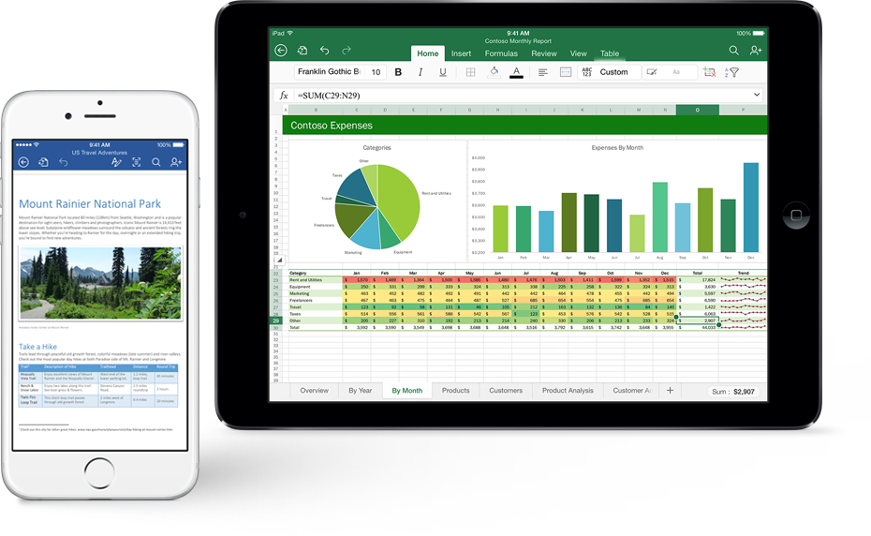
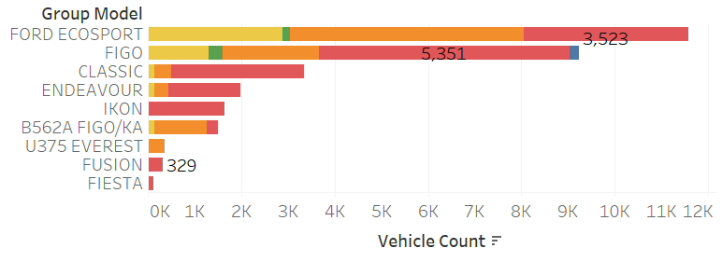
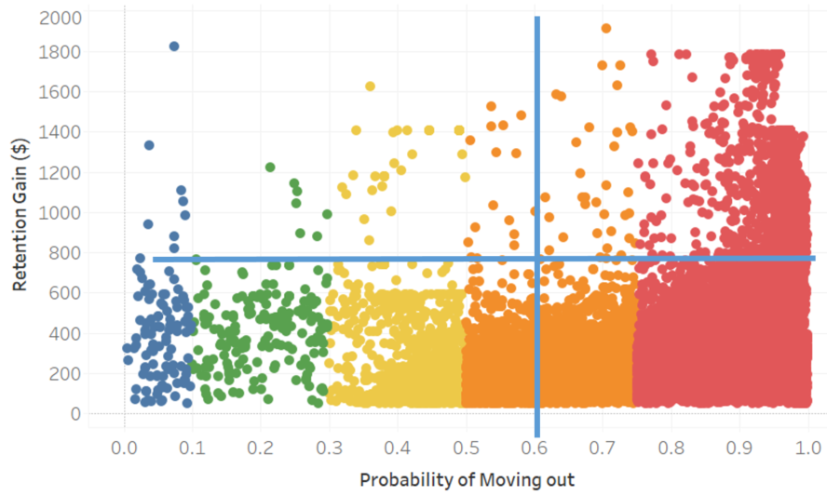
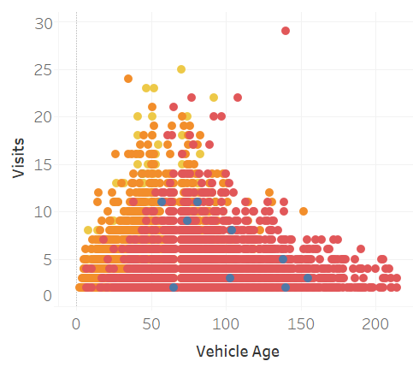
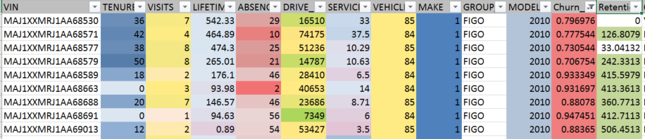
Insights in hand
Service Advisor Aid System
12345 – Service Center
Service Advisor Aid System
MAJUXXMR2UBU18888
Mr. Happy Singh
SEDAN - 2011
90.61%
$1,440
Churn Score
Retain Gain
1,618
15 Kms.
Loyalty Score
Travel Dist.
Service History
11m ago
Last Visit
Last Feedback
At least give me a ride back to my home.

Slide 3
Solution Statement
Capability in the hands of Dealership that retains the Customer while
enriches Consumer experience

Slide 4
Customer Churn model
Predict customer churn with 90%+ accuracy based on real service data
Develop insights about Customers

Slide 5
Basics Assumptions to start
Churn
Not visited in last 12 18 months
Today
Not Churn
Visited in last 18 months

Slide 6


Data :
service
vehicle
customer
Tenure – Relationship duration with dealership
Visits - # of services
Total customer Spent– total revenue generated by VIN
Absence – Months since last visit
avg. time to service
Avg. Delay in Delivery
Department
Missed PMS
VIN
Drive life– Odometer reading
Vehicle age
Make – Ford Lincoln
model
model year
used vehicle
fuel type - Petrol/Diesel
Zip code
Region
Gender
Loyalty Points
Feedbacks
ESB Plan
Preferred Insurance

Slide 7
Data details
last visited date
visits
Churn
absence
∑
$
$
$
$
lifetime
customer value
Today
Not Churn
tenure
Visited in last 6 months

Slide 8



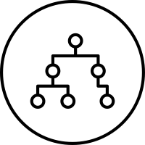


Data Acquisition
Machine Learning
Problem
statement
Design Approach
Get Data
Transform
Business Understanding
Inference
Algorithm
evaluate
visualize
communicate
model
Process
train
test

Slide 9
Approach
Develop score at CustomerID level to predict whether a customer will come back to dealership or move away
Segment the data for customer profiling
Data (prototype) – Service data of 8 Dealers from 4 regions
Algorithm – Gradient Boost, XGB, Logistic Regression
Service Raw Data
Label Churn
2.4
2.4
Imputation/ Feature Eng.
visualize
Service Data
ESB Raw
ESB Cleansed
Missed PMS
ESB Data
Model
Train
Test
Validate
Reality Check
Quick Touch Call Raw
Quick Touch call Cleansed
Feedback
Quick Touch Call

Slide 10
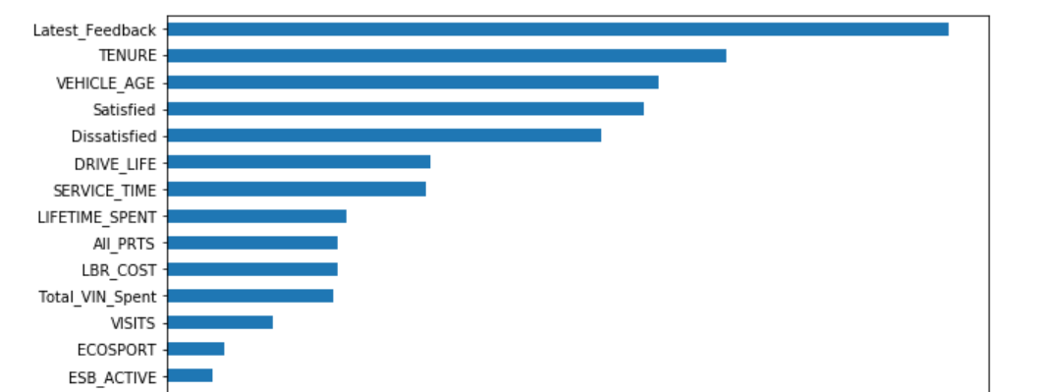
Feature Importance

Slide 11
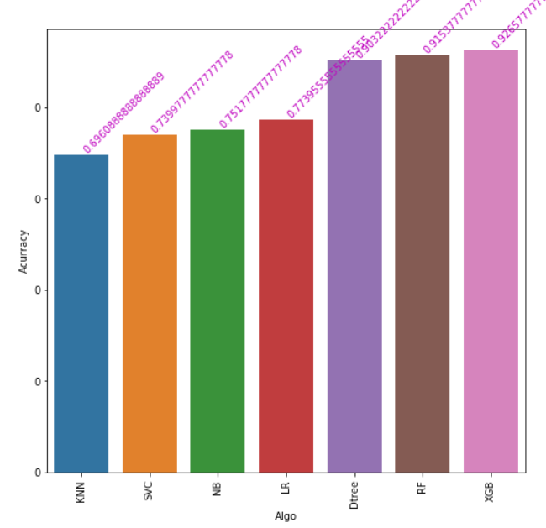
Model Accuracy

Slide 12
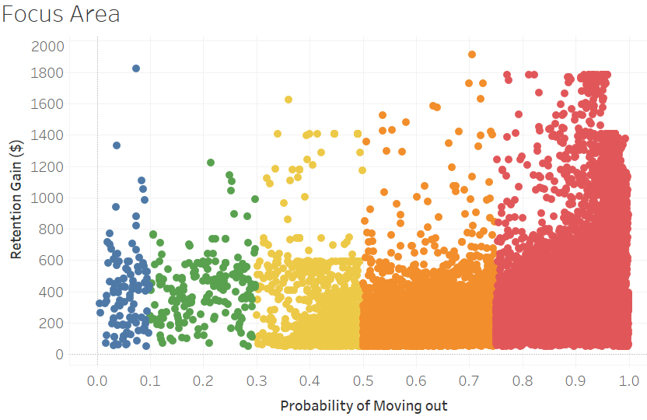
Area to Focus

Slide 13
Guidance required
Feedback on the current model
Idea to Product – Journey
Parameters that should be included
Insights that must be targeted
Is it possible to use customer zip code in model

Slide 14
Thanks

Slide 15
Appendix

Slide 16
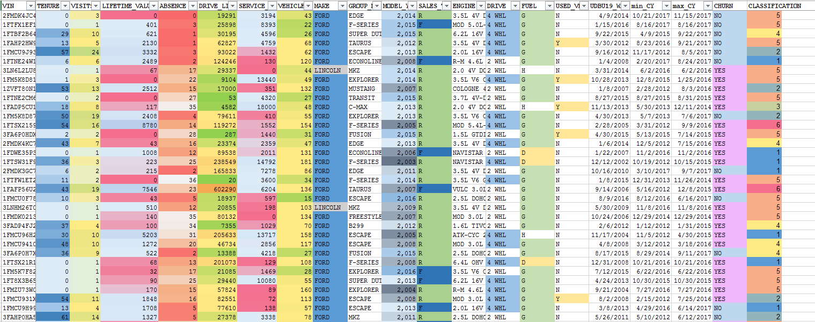
Labeled Data

Slide 17
Feedback Received
Churn Label – Label customer as Churned with absence >18 months
Include secondary dealers too
Parameters included
Customer Region
Customer Gender - blanks
Delay in Delivery – Dealer practice issue
EBS – Servis2
Preferred Insurance- NA
Quick touch call Feedback – Consumer Exp.
Missed PMS
Skip Irrelevant Data
Retention Gain – Customer Lifetime value available with Business

Slide 18
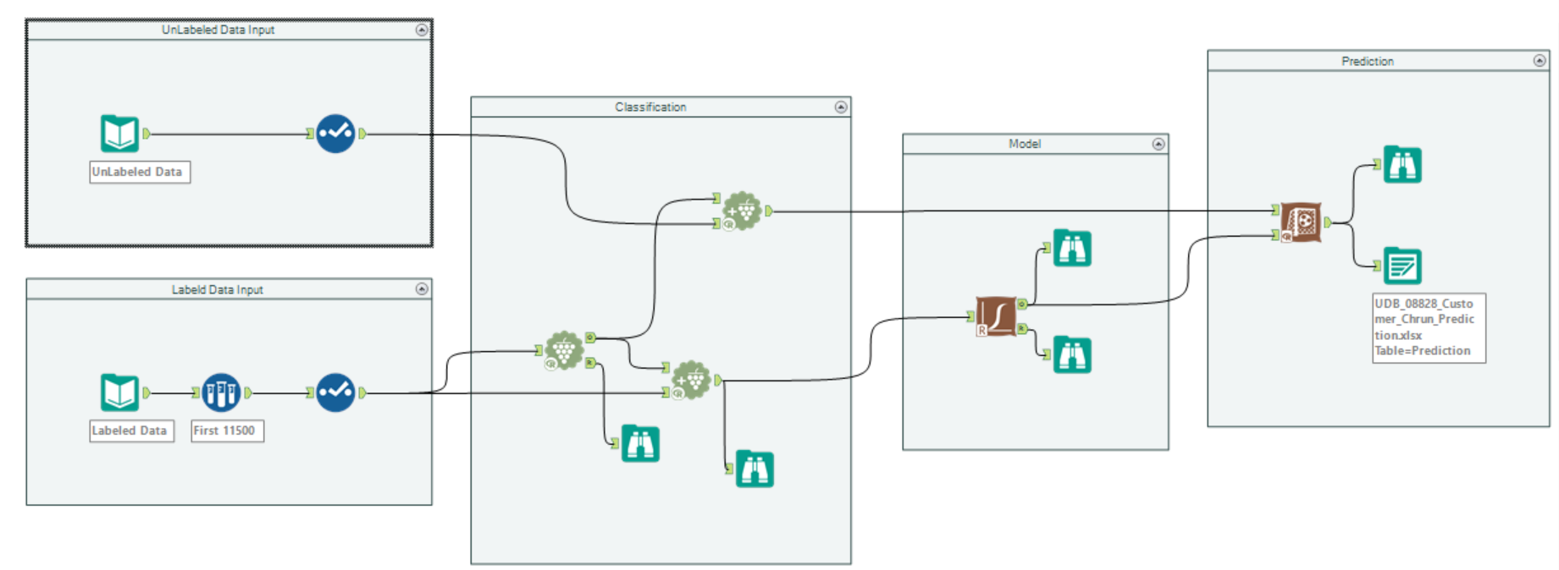
Model Flow
Decision Tree
Naïve Bayes

Slide 19
Classification
K Means
Segments |  | TENURE | VISITS | LIFETIME_VALUE | DRIVE_LIFE | SERVICE_TIME | VEHICLE_AGE
Long Drive life | 1 | -0.5847 | -0.5808 | -0.0394 | 1.4784 | -0.2283 | -0.0419
Least service time | 2 | 1.54394 | 1.63812 | 0.87223 | 0.43904 | -0.1176 | -0.0623
Long Service time | 3 | -0.5249 | -0.4247 | -0.1145 | -0.1175 | 2.79787 | 0.00173
long tenure | 4 | 0.68673 | 0.24019 | -0.1651 | -0.1647 | -0.1557 | -0.0746
Shortest tenure | 5 | -0.7141 | -0.5489 | -0.4273 | -0.5628 | -0.2263 | 0.07923
High Value Customer | 6 | 1.56231 | 2.37787 | 3.99837 | 1.36572 | 0.11468 | -0.0505
 |  | 1.969283 | 2.701819 | 4.12424 | 2.438122 | 2.184677 | -0.14848

Slide 20
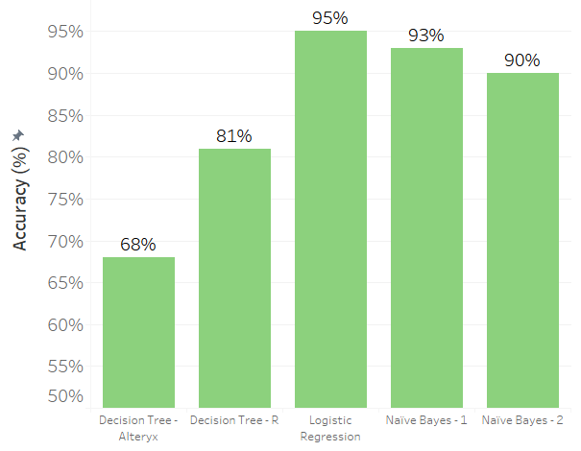
Creating Model
Naïve Bayes
Decision Tree
Logistic Regression

Slide 21
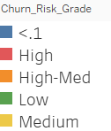
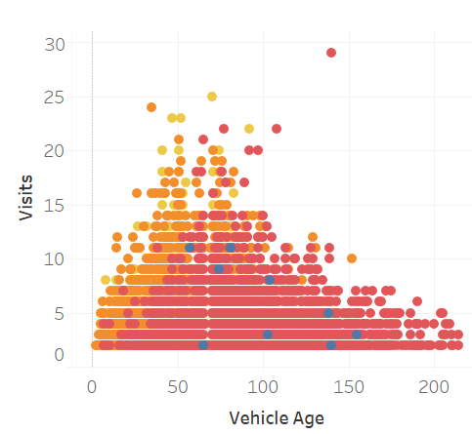
Developing insights

Slide 22
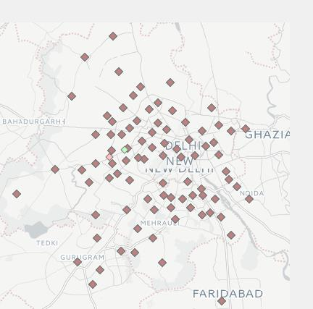
Market Area

Slide 23
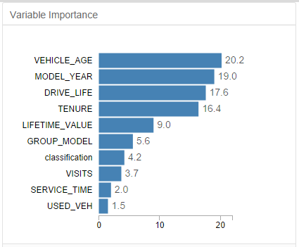
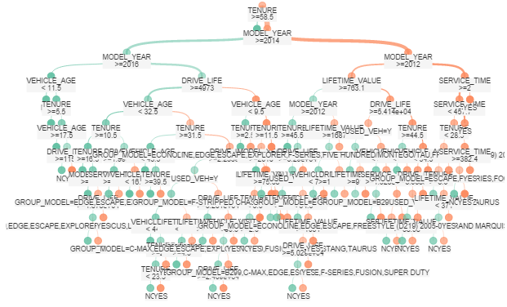
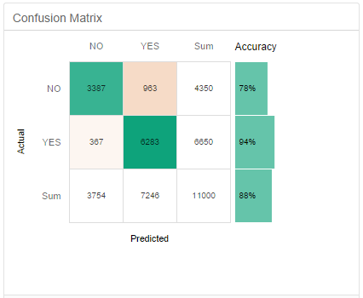
Decision Tree - Alteryx

Slide 24
Evaluating Model
Naïve Bayes - R
93%
accuracy
YES
NO

Slide 25
Decision Tree - Alteryx
68%
accuracy
YES
NO

Slide 26
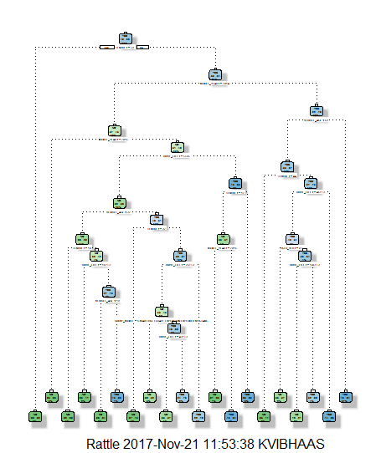
Decision Tree - R
81%
accuracy
YES
NO

